Slide 1
WEEK 6 Lab meeting
Doan Manh Hung
Oct 10th, 2014

Slide 2
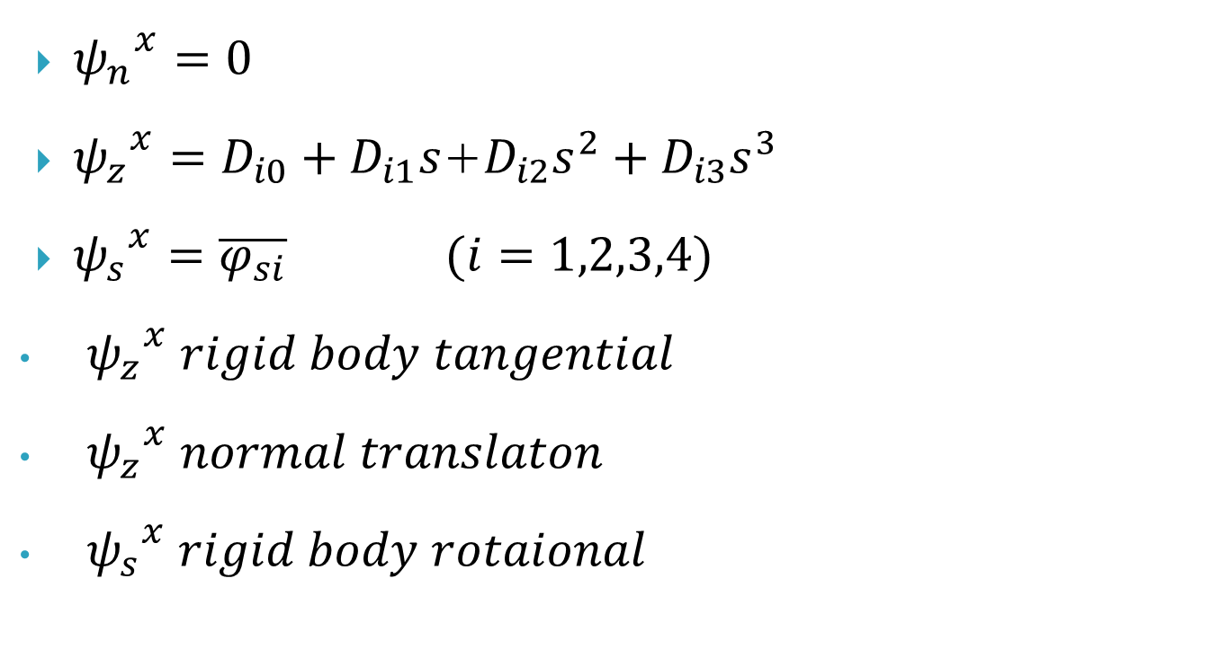
Distortion Shape Function
${ψ_{n}}^{x}=0$
${ψ_{z}}^{x}=D_{i0}+D_{i1}s$+$D_{i2}s^{2}+D_{i3}s^{3}$
${ψ_{s}}^{x}=\overline{φ_{si}} (i=1,2,3,4)$
${ψ_{z}}^{x} rigid body tangential$
${ψ_{z}}^{x} normal translaton$
${ψ_{s}}^{x} rigid body rotaional$

Slide 3
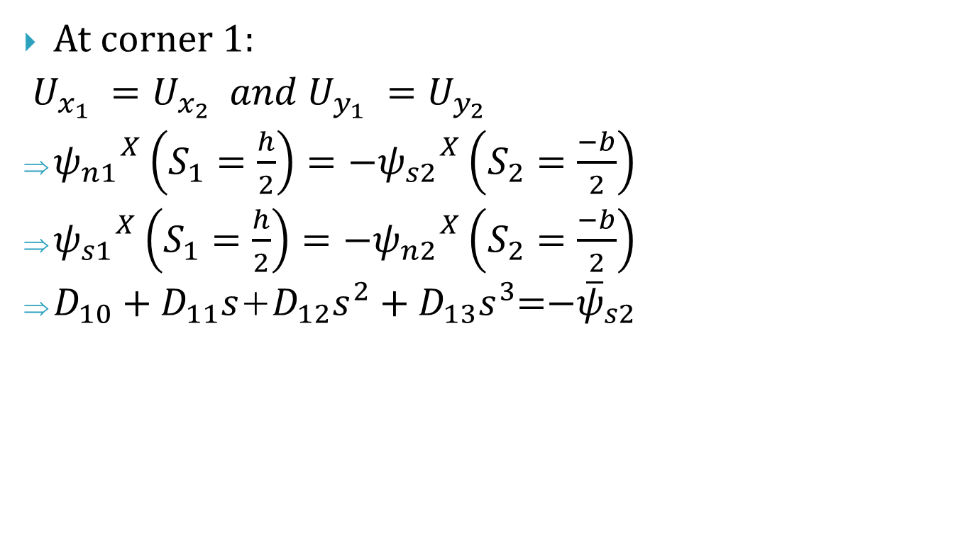
1. Continuity conditions
At corner 1:
$U_{x_{1} }=U_{x_{2} } and{ U}_{y_{1} }=U_{y_{2} }$
${ψ_{n1}}^{X}\left(S_{1}=\frac{h}{2}\right)=−{ψ_{s2}}^{X}\left(S_{2}=\frac{−b}{2}\right)$
${ψ_{s1}}^{X}\left(S_{1}=\frac{h}{2}\right)=−{ψ_{n2}}^{X}\left(S_{2}=\frac{−b}{2}\right)$
$D_{10}+D_{11}s$+$D_{12}s^{2}+D_{13}s^{3}$=${−\overline{ψ}}_{s2}$

Slide 4

2. Slope continuity
At corner 1:
$$\frac{{dψ_{n1}}^{χ}}{ds}\left|s1=\frac{h}{2}=\right.\frac{{dψ_{n2}}^{χ}}{ds}\left|s2=\frac{−b}{2}\right.$$
=> $D_{11}$+${2D}_{12}(\frac{h}{2})+{3D}_{13}{(\frac{h}{2})}^{2}$=$D_{21}$+$2D_{22}(\frac{h}{2})+{{3D}_{23}(\frac{h}{2})}^{2}$

Slide 5

3. Moment continuity
At corner 1:
$$\frac{{d^{2}ψ_{n1}}^{χ}}{{ds}^{2}}\left|s1=\frac{h}{2}=\right.\frac{{d^{2}ψ_{n2}}^{χ}}{{ds}^{2}}\left|s2=\frac{−b}{2}\right.$$
=> ${2D}_{12}+{6D}_{13}\frac{h}{2}$=${2D}_{22}+{6D}_{23}\frac{h}{2}$

Slide 6
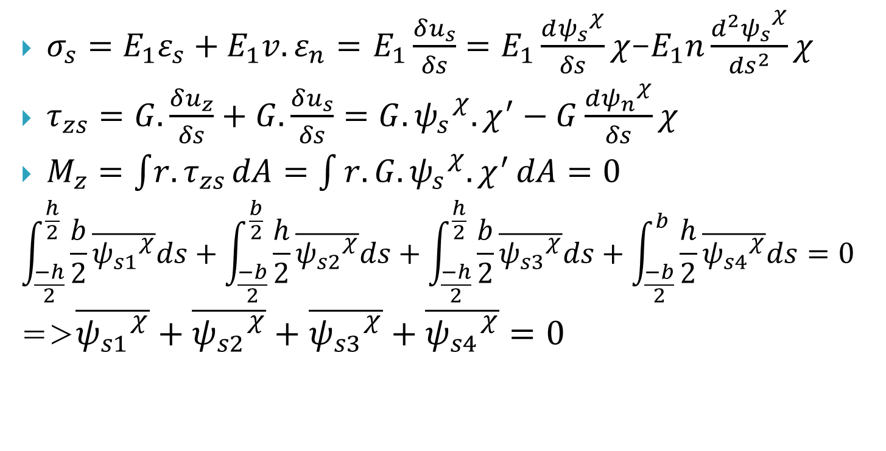
4. No resultant conditions
$σ_{s}=E_{1}ε_{s}+E_{1}{v.ε}_{n}=$ $E_{1}\frac{δu_{s}}{δs}=E_{1}\frac{{dψ_{s}}^{χ}}{δs}χ$-$E_{1}n\frac{{d^{2}ψ_{s}}^{χ}}{{ds}^{2}}χ$
$τ_{zs}=G.\frac{δu_{z}}{δs}+G.\frac{δu_{s}}{δs}=G.{ψ_{s}}^{χ}.χ^{′}−G\frac{{dψ_{n}}^{χ}}{δs}χ$
$M_{z}=\int{r.τ_{zs}}dA=\int{r.G.{ψ_{s}}^{χ}.χ^{′}}dA=0$
$$\int_{\frac{−h}{2}}^{\frac{h}{2}}{\frac{b}{2}}\overline{{ψ_{s1}}^{χ}}ds+\int_{\frac{−b}{2}}^{\frac{b}{2}}{\frac{h}{2}}\overline{{ψ_{s2}}^{χ}}ds+\int_{\frac{−h}{2}}^{\frac{h}{2}}{\frac{b}{2}}\overline{{ψ_{s3}}^{χ}}ds+\int_{\frac{−b}{2}}^{b}{\frac{h}{2}}\overline{{ψ_{s4}}^{χ}}ds=0$$
=>$\overline{{ψ_{s1}}^{χ}}+\overline{{ψ_{s2}}^{χ}}+\overline{{ψ_{s3}}^{χ}}+\overline{{ψ_{s4}}^{χ}}=0$

Slide 7
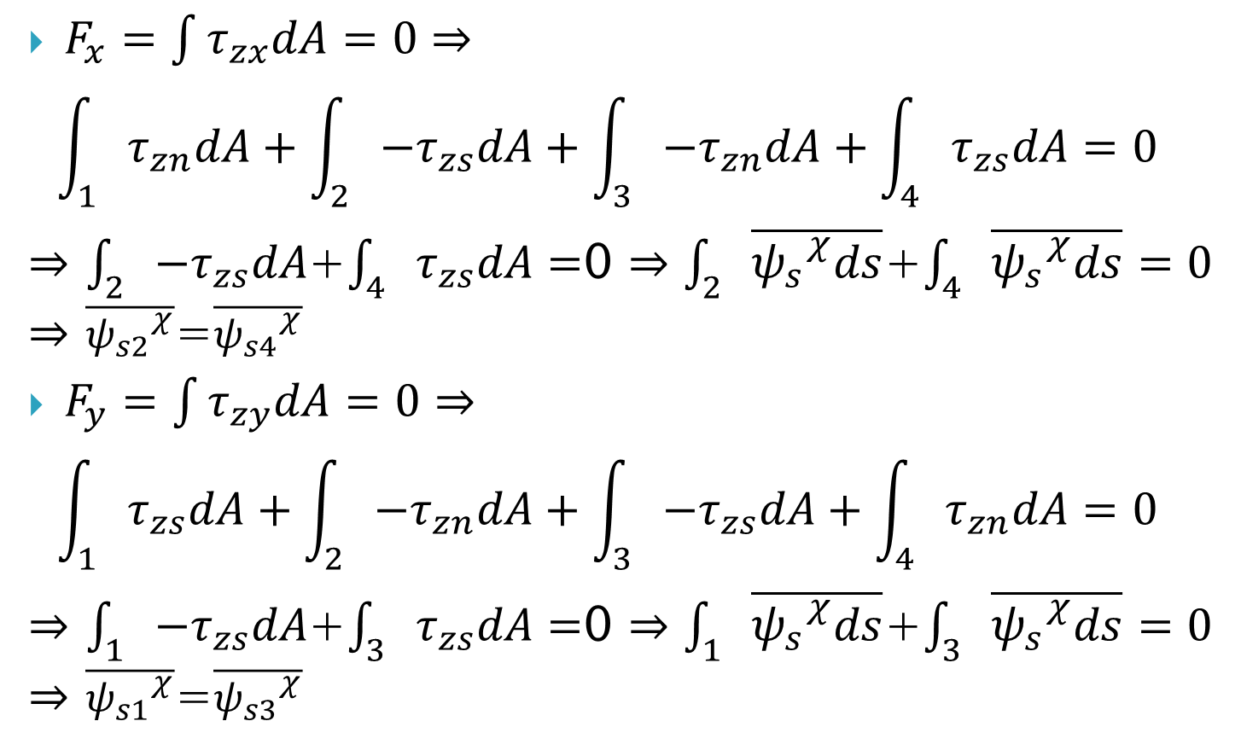
$F_{x}=\int{τ_{zx}dA}=0⇒$
$$\int_{1}{τ_{zn}dA}+\int_{2}{{−τ}_{zs}dA}+\int_{3}{{−τ}_{zn}dA}+\int_{4}{τ_{zs}dA}=0$$
$⇒$ $\int_{2}{{−τ}_{zs}dA}$+$\int_{4}{τ_{zs}dA}=$0 $⇒\int_{2}{\overline{{ψ_{s}}^{χ}ds}}$+$\int_{4}{\overline{{ψ_{s}}^{χ}ds}}=0$
$⇒$ $\overline{{ψ_{s2}}^{χ}}$=$\overline{{ψ_{s4}}^{χ}}$
$F_{y}=\int{τ_{zy}dA}=0⇒$
$$\int_{1}{τ_{zs}dA}+\int_{2}{{−τ}_{zn}dA}+\int_{3}{{−τ}_{zs}dA}+\int_{4}{τ_{zn}dA}=0$$
$⇒$ $\int_{1}{{−τ}_{zs}dA}$+$\int_{3}{τ_{zs}dA}=$0 $⇒\int_{1}{\overline{{ψ_{s}}^{χ}ds}}$+$\int_{3}{\overline{{ψ_{s}}^{χ}ds}}=0$
$⇒$ $\overline{{ψ_{s1}}^{χ}}$=$\overline{{ψ_{s3}}^{χ}}$

Slide 8
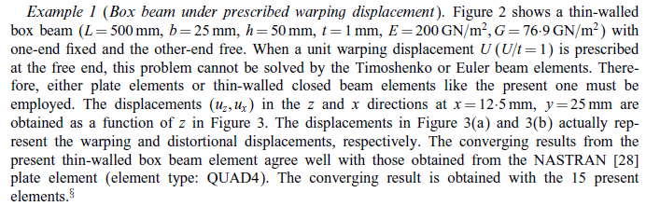

Slide 9
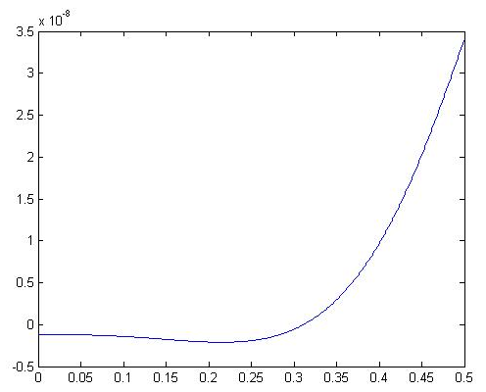
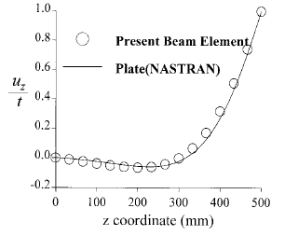
Uz= 3.4127e-008 m

Slide 10
Going to do next week
Do example in 2 papers

